Slide 1
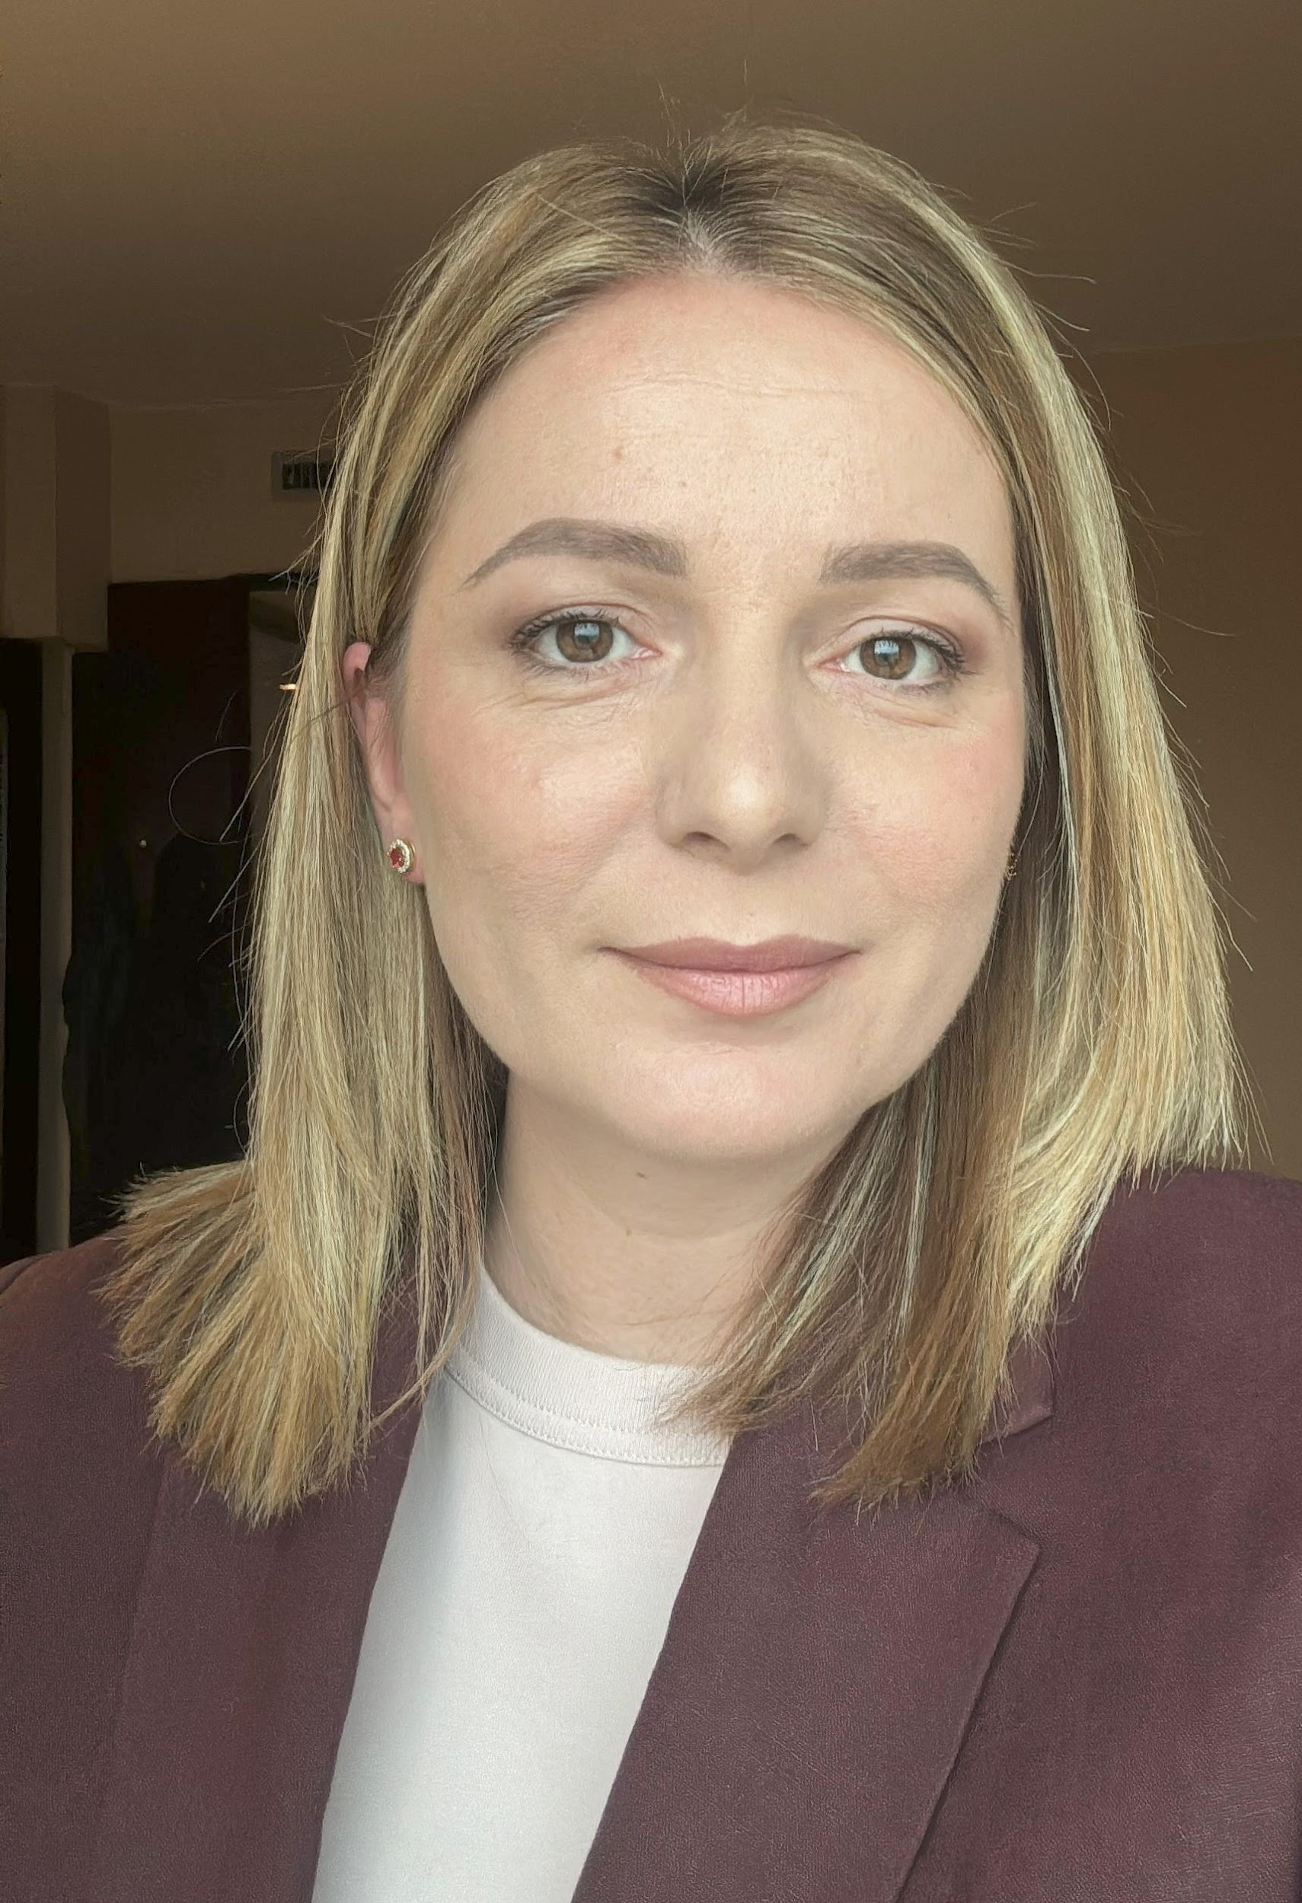
Marjana Prifti Skenduli
Postdoctoral Researcher in Quantum Machine Learning | Università degli studi di Bari Aldo Moro
Founder of Albanian Center for Artificial Intelligence (AI Albania)

Started industry leadership path as Information Technology Manager

Started as a full time Computer Science faculty member at UNYT

Founded AI Albania and joined the Council of Europe Expert Group on AIED
2005
2012
2016
2021
2023
2024
Completed your MSc in Computer Science

Completed your PhD in Computer Science

Started the postdoctoral role in Quantum Machine Learning at UNIBA


